Slide 1

PROJECT 3
TEAM EDITION
CYPRESS
AARON PARANGAN
DEAN BAETEN
CODY ELZEY
SHANE CONDON
MATT VROMAN
AL BROWN

Slide 2
Project BACKGROUND
Surpassing it’s 5-year initial pilot program, The U.S. Department of Veterans Affairs (VA) has hired Everett Enterprises (E2) to provide an audit on Preferred status VET TECH programs for funding distribution and expansion. E2 has been working on a rating website for the last 15 weeks and are ready to provide the VA with a Minimal Viable Product (MVP). This site will allow graduates to apply a rating score based on their specialized cohort experience. The results will be viewed amongst the VA Education and Training Department which will propose a new increased funding ceiling in reference to Section 4301: Expansion of VET TECH Program.
E2 has commissioned Cypress Cloud Solutions LLC to build a publicly accessible website, including a private database, as a collective for VET TECH ratings
Project minimum requirements for the site is it must be a fast, scalable, reliable, and cost-effective application in the AWS Cloud

Slide 3
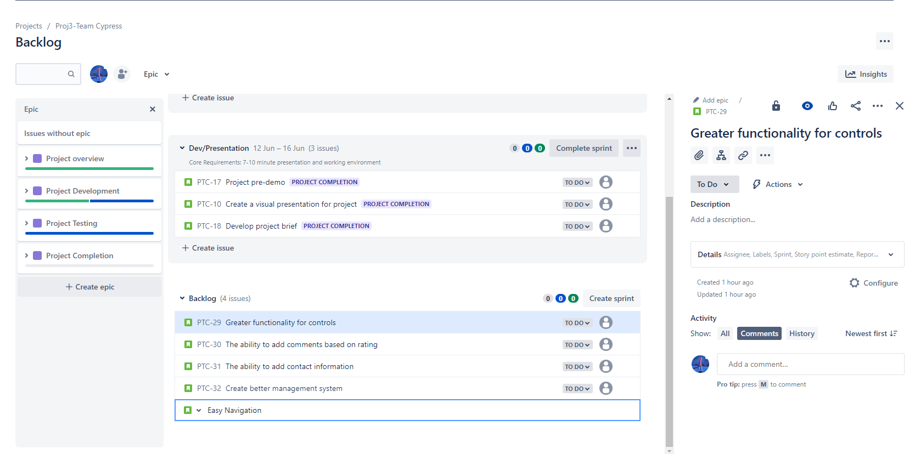
PROJECT MANAGEMENT

Slide 4






PRESENTATION
AUTHENTICATION TIER
SECURITY/COMPUTE TIER
STORAGE TIER
users
AWS Identity and Access Management
AWS Amplify
Amazon API Gateway
AWS Lambda
Amazon DynamoDB

Slide 5
PROJECT 3
Demo

Slide 6
LESSONS LEARNED
DO THE RESEARCH
ONE TEAM ONE FIGHT!
AWS SERVICES OWNERS MANUALS
A SOLUTIONS ARCHITECT’S KEY TO SUCCESS
GOOGLE, AWS TOOLBOX, SILENT PARTNER
EVERY TEAM MEMBER HAS STRENGTHS AND AREAS FOR IMPROVEMENT
A STRONG TEAM IS MORE CAPABLE THAN THE INDIVIDUAL
SYNTAX
TIME MANAGEMENT
WRITE ONCE - CHECK TWICE – TEST OFTEN
TWO SETS OF EYES ARE BETTER THAN ONE
TAKE BREAKS!! BEER-THIRTY
BEGIN EARLY
SHARE THE WORKLOAD
PRIORITIZE A PROJECT AND STUDY BALANCE

Slide 7



THANK YOU
https://developer.hashicorp.com/terraform
https://www.jenkins.io/
HTTPS://AWS.AMAZON.COM/AMPLIFY
HTTPS://AWS.AMAZON.COM/API-GATEWAY
HTTPS://AWS.AMAZON.COM/LAMBDA
HTTPS://AWS.AMAZON.COM/IAM
HTTPS://AWS.AMAZON.COM/DYNAMODB

